Slide 1
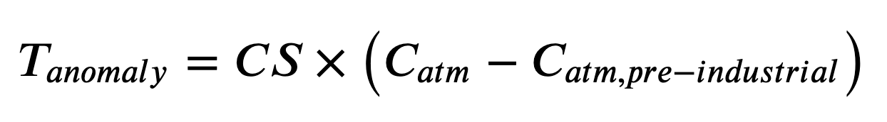
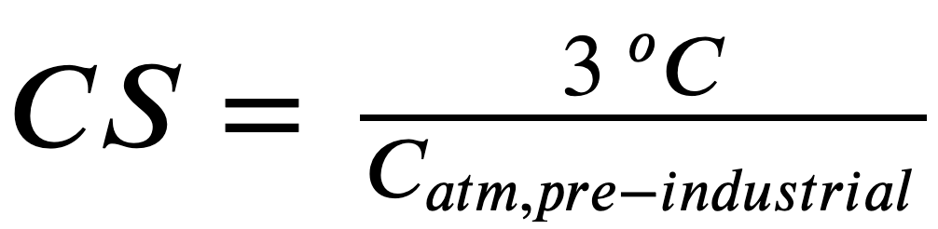
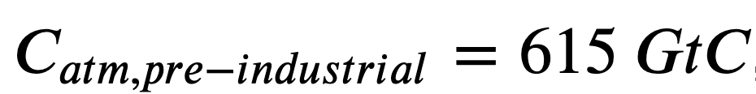
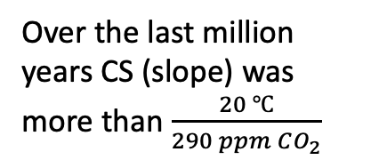

The temperature anomaly as a diagnostic variable
Over the last million years CS (slope) was more than $\frac{20 ℃}{290 ppm CO_{2}}$
T (relative to 1960)
Over the last 150 years, CS has been about $\frac{2.7 ℃}{290 ppm CO_{2}}$
Courtesy Penny Rowe
Courtesy Penny Rowe

